Slide 1
Taxation, Inequality and Development
Michelle D’Arcy
Department of Political Science, Trinity College Dublin

Slide 2
Tax, Inequality and Justice
Tax and spending = major instruments of redistribution
Fiscal contract = citizens consent to pay tax in return for services and fiscal policy underpins relationship between citizens and state
Varying Levels of Redistribution:
  Sweden: high redistribution, low inequality
  US: low redistribution, high inequality
Varying fiscal contracts:
  Sweden: broad based regressive taxes, universal services
  US/Ireland: narrower more progressive tax base, limited services
Most equalizing fiscal contract: everyone pays tax, everyone gets services in return

Slide 3

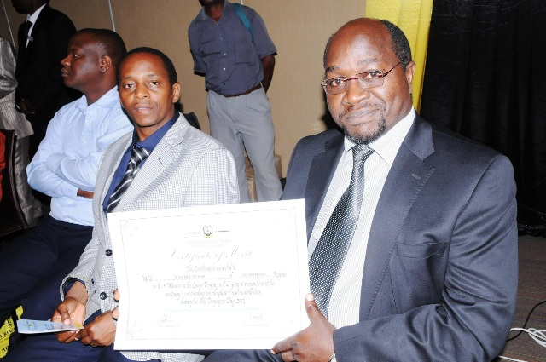
Taxation in Global South
Fiscal Contract in Global South: no one is paying tax, no one is getting services
Registered tax payers: 400,000
2005: 70 % of the domestic revenues from 286 large taxpayers
Tax % GDP: 15%
ODA % GDP: 10%
Motto: We make it easy to pay tax
and make lives better

Slide 4
Vicious cycle: An equilibrium
Low tax capacity
Low incentives to comply

Slide 5
Vicious cycle: An equilibrium
Poor services
Low incentives to comply

Slide 6
Globalization, Tax Evasion and the Fiscal Contract
Tax evasion erodes fiscal contract:
  Less tax
  Less trust
  More corruption and clientelism
Economic behaviour and financial flows need to be visible

Slide 7
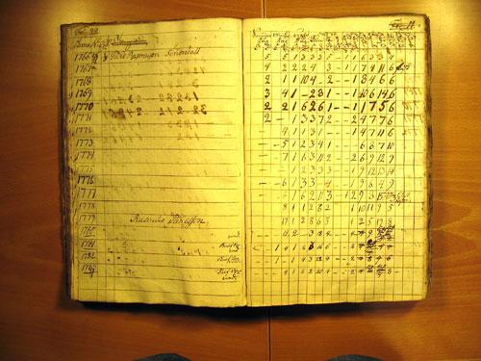

Early Modern Sweden
Swedish tax register, 1740s
Cadastral map, 1628

Slide 8
Globalization, Tax Evasion and the Fiscal Contract
Tax evasion erodes fiscal contract:
  Less tax
  Less trust
  More corruption and clientelism
Economic behaviour and financial flows need to be visible
  Need a global financial cadaster

Slide 9
Vicious cycle: An equilibrium
Tax evasion
Low tax capacity
Low incentives to pay tax

Slide 10
Vicious cycle: An equilibrium
Tax evasion
Poor services
Low incentives to pay tax

Slide 11
Vicious cycle: An equilibrium
Tax evasion
Poor services
Incentives to clientelism

Slide 12
Vicious cycle: An equilibrium
Poor services
Low incentives to comply

Slide 13
Taxation in Developing Countries
What kind of fiscal policy reduces inequality?
Strong fiscal contract: broad based taxes, universal services
Not what we see in most developing countries:
  Most tax revenue from import, corporation, sales taxes
  Bulk of population outside the tax net -> no fiscal contract
  Difficulties providing services -> trapped in sub-optimal low compliance equilibrium

