Slide 1


FINANCIAL JUSTICE IRELAND CLIMATE JUSTICE, CLIMATE ACTION AND ECONOMICS
Updated May 2025 vicky@financialjustice.ie

Slide 2

OPENING REFLECTION:
‘Challenging Times’
Something that gives you hope / encouragement / energy…

Slide 3
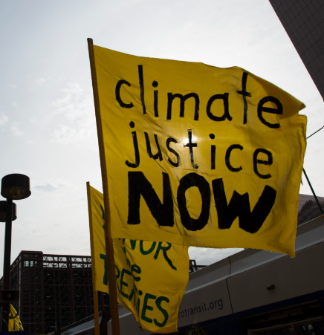
INTRODUCTORY ACTIVITY:
What makes climate change a justice issue?

Slide 4
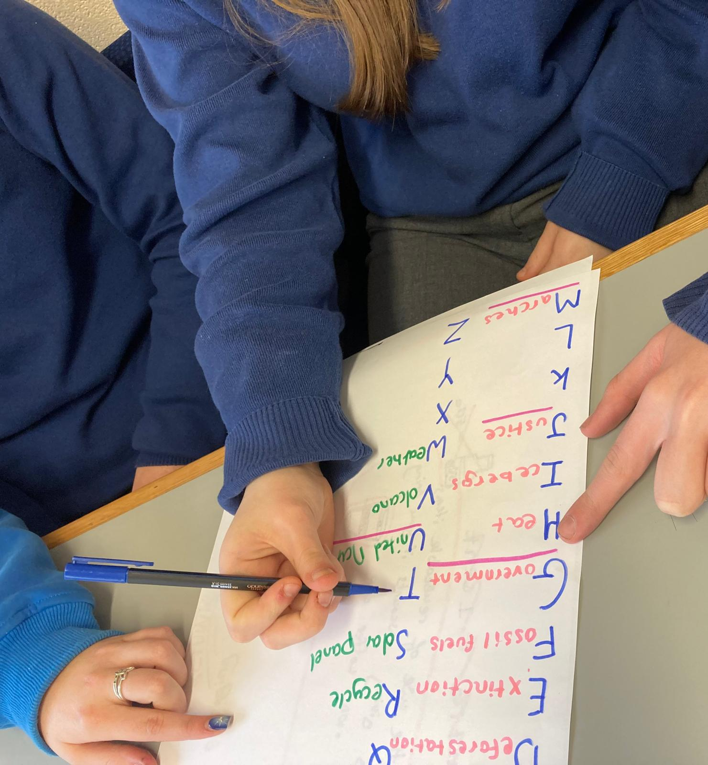
A – Z OF CLIMATE CHANGE
Materials: Large page, marked A - Z Markers Timer Step One: - Set the timer for 2 minutes. - In small groups the students race against the clock to fill in all the blanks with words related to climate change. - Take some feedback – note common terms, and any creative inputs. Step Two: Each group underlines any words connected to climate justice. Step Three: Invite the groups to finish the sentence “Climate justice is about…” or Climate is a justice issue because…” Weave contributions from each group to build a definition of climate justice.

Slide 5
WHAT MAKES CLIMATE CHANGE A JUSTICE ISSUE?
1.Who’s responsible? 2. Who/where are the consequences being felt? 3.Who makes decisions about this issue – who has the biggest say? Who should have? 3. Solutions – who benefits/loses

Slide 6
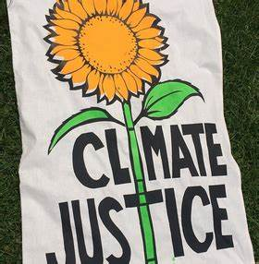
ACTIVITY: SMALL GROUPS
What does climate justice mean to us?

Slide 7

CLIMATE JUSTICE
“Climate Justice links human rights and development to achieve a human-centred approach, safeguarding the rights of the most vulnerable people, both at home and abroad, and sharing the burdens and benefits of climate change and its impacts equitably and fairly.”
Mary Robinson Foundation,
Geography of Climate Justice.

Slide 8
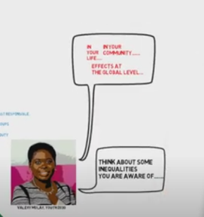
VIDEOS:
What is Climate Justice (Oxfam 2022/1.05 min) www.youtube.com/watch?v=pHRu0VV-Dbw
An Introduction to Climate Justice (National Youth Council of Ireland 2021/ 3.20 min) www.youtube.com/watch?v=NEnpPC8pIkE This is How Unfair Climate Change Is DW Future A 2022 / 10.00 min www.youtube.com/watch?v=pHRu0VV-Dbw

Slide 9
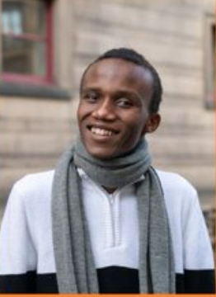
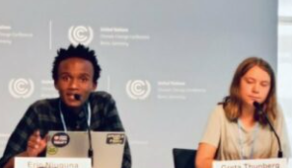
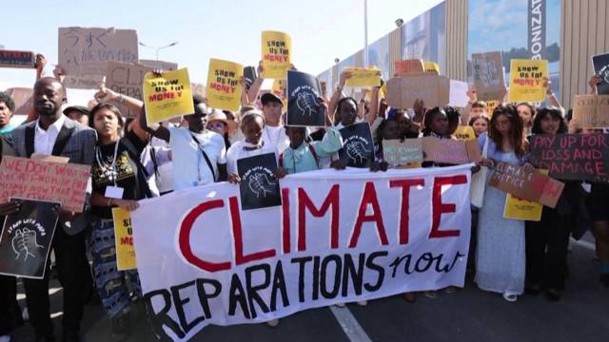
UNDERSTANDING CLIMATE JUSTICE
Njuguna started their climate activism in 2017 after severe droughts in Nairobi impacted their school's water supply by organizing with the group Zero Hour and then Fridays for Future Kenya. In August 2021, Njuguna co-authored an essay with Greta Thunberg, Adriana Calderón, and Farzana Faruk Jhumu that was published in The New York Times. Their co-authored essay highlighted a 2021 UNICEF report that stated 2.2 billion children are at "extremely high-risk" of experiencing the consequences of climate change.
“Across the globe, people who have the least role in causing the climate crisis are bearing the brunt of it. And unfortunately, climate justice is not talked about enough."
Eric Njuguna, Youth Climate Justice Organizer

Slide 10

CLIMATE JUSTICE
Fill in the blanks, and guess who said it: “The fact that 3 billion people use less energy [per person, per year] than a
______ ______ ______ gives you an idea of how far away from global equity and climate justice we currently are.”

Slide 11
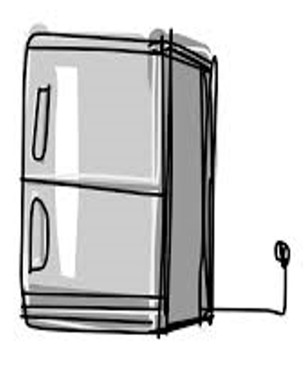
QUESTION: CLIMATE JUSTICE
Answer: Greta Thunbrug: “The fact that 3 billion people use less energy, on an annual per capita basis, than a standard American refrigerator gives you an idea of how far away from global equity and climate justice we currently are.”
Greta Thunberg (2022) www.theguardian.com/environment/2022/oct/08/greta-thunberg-climate-delusion-greenwashed-out-of-our-senses
Notes:
The best answer to this question so far has been ‘than a Taylor - Swift - concert.

Slide 12
CLIMATE JUSTICE WHO DO WE COUNT?
“If everyone lived like we do in Sweden, we would need the resources of 4.2 planet Earths to sustain us…
The fact that 3 billion people use less energy, on an annual per capita basis, than a standard American refrigerator gives you an idea of how far away from global equity and climate justice we currently are”
Greta Thunberg (2022) www.theguardian.com/environment/2022/oct/08/greta-thunberg-climate-delusion-greenwashed-out-of-our-senses

Slide 13
CRITICAL THINKING ABOUT CLIMATE ACTION ‘OUR ANALYSIS OF THE PROBLEM WILL DETERMINE THE SOLITIONS WE PURSUE’
HOW DO WE COUNT
WHEN DO WE START COUNTING?
WHO DO WE COUNT?
WHAT DO WE COUNT? WHERE DO WE COUNT?
WHY DO WE COUNT? WHICH ACTIONS COUNT? Let’s talk!

Slide 14
CRITICAL THINKING ABOUT CLIMATE
Consider the following questions about how we measure emissions. What different perspectives will each give us? Which approach is more fair, why?
HOW DO WE COUNT? Do we count emissions by country or per capita?
WHEN DO WE START COUNTING? The climate crisis has been many years in the making? Do we look at emissions today? Or do we assess the build up of emissions since pre-industrial times?
WHO DO WE COUNT? Are all people within a country consuming fossil fuels at the same rate? Do we consider emissions to be linked to individual behaviour – or to the economics systems driving consumption?
Do we assume that emissions are the same for all the people in a country or region?
WHAT DO WE COUNT? Emissions at source, or embedded carbon? What sectors are included or excluded from emissions targets? WHERE DO WE COUNT? Do we count emissions where they’re produced – or where they are consumed?
WHY DO WE COUNT? Who, or what is seen as responsible, who or what is being held accountable?
Is the point to push individuals to take personal responsibility for their own actions as consumers? Or…? WHICH ACTIONS COUNT? Let’s talk!

Slide 15
CLIMATE AND POWER: DISTRIBUTION OF GLOBAL WEALTH
Richest 20% of world’s population controls
X%
of the world’s wealth
Poorest 80% of world’s population controls
X%
of the world’s wealth

Slide 16
DISTRIBUTION OF GLOBAL WEALTH
Richest 20% of world’s population controls
94%
of the world’s wealth
Poorest 80% controls
6%
of the world’s wealth
Notes:
Oxfam 2015

Slide 17

NARRATIVES OF POVERTY AND WEALTH
2 minute dialogue:
HOW DID ‘POOR COUNTIRES’ BECOME POOR?
HOW DID ‘RICH COUNTRIES’ BECOME RICH? What messages/lessons do we get about this?

Slide 18

CRITICAL THINKING ABOUT CLIMATE…
HOW DO WE COUNT?
WHO DO WE COUNT?
WHAT DO WE COUNT?
WHERE DO WE COUNT?
WHY DO WE COUNT? WHICH ACTIONS COUNT?

Slide 19
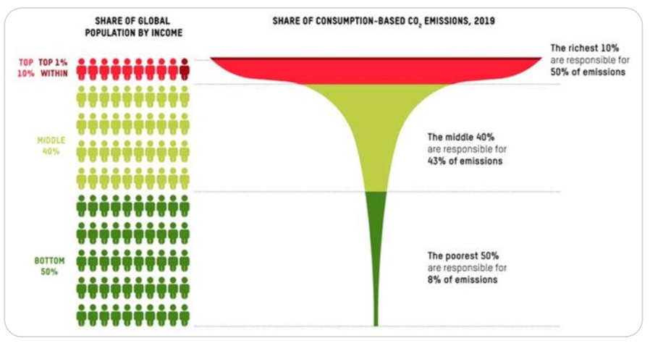
CLIMATE JUSTICE: WHICH PEOPLE? / WHO DO WE COUNT? CLIMATE EQUALITY: A PLANET FOR THE 99% (OXFAM 2023) HTTPS://POLICY-PRACTICE.OXFAM.ORG/RESOURCES/CLIMATE-EQUALITY-A-PLANET-FOR-THE-99-621551/
If climate change is caused by ’humans’, should we be asking ‘which humans’?
1. Global South – Global North?
2. Do young people have the same responsibility as older people?
3. Who has the most decision-making power in society? Does income come into this? Gender? What else?
4. Who drives from the system that drives climate change and environmental harm? Who benefits and who loses out?

Slide 20
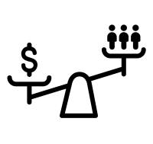
QUESTIONS OF CLIMATE JUSTICE: WHO DO WE COUNT?
“Wealth is power”
Globally, the wealthiest 10% of the world’s population are responsible for about half of all greenhouse gas emissions, while the poorest half of the world contributes just 12% of all emissions. This inequality occurs within countries too. In the USA, the wealthiest 10% of people are responsible for seven times more CO2 emissions every year than the poorest half of the population, while in Europe it’s six times more. Look deeper: View and discuss this data on the World Inequality Database

Slide 21
HOW DO WE COUNT? ACTIVITY: PART 1
ARRANGE THE COUNTRIES
IN ORDER OF EMISSIONS
– FROM HIGHEST TO LOWEST
Which country has the highest emissions
in the world?
Notes:
Print and cut out the country cards on the following slide (one set per group if the class is working in small groups) Invite the group to arrange the countries in the order of C02 emissions, from highest to lowest. Prompt with critical thinking questions about how they know this, or what sources of information they’re drawing from. Then share the ‘answer cards’ and rearrange if necessary. For Part 2, point out that this question was about Co2 emissions per country. Do they think the picture would change if they were ranking emissions per person/per capita. Invite the group to rearrange – again prompt with questions to reflect on their world view, and then share the answers. Any surprises. Ask the group to come up with a way to show the scale of difference in emissions. They might mark line on the ground in tape, and arrange the cards in their relative positions. Group work: using the links provided, search for the position of countries in terms of emissions (Ireland, for example is the

Slide 22
HOW DO WE COUNT? PART 2
ARRANGE THE COUNTRIES
IN ORDER OF EMISSIONS PER PERSON [PER CAPITA]
– FROM HIGHEST TO LOWEST

Slide 23
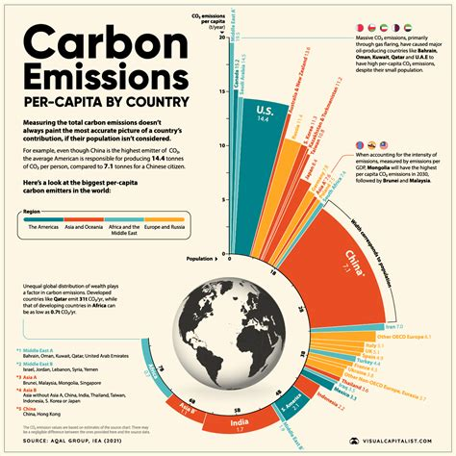
HOW DO WE COUNT ACTIVITY
Print and cut out the country cards on the following slide (one set per group if the class is working in small groups)
Invite the group to arrange the countries in the order of C02 emissions, from highest to lowest. Prompt with critical thinking questions about how they know this, or what sources of information they’re drawing from.
Then share the ‘answer cards’ and rearrange if necessary. For Part 2, point out that this question was about Co2 emissions per country. Do they think the picture would change if they were ranking emissions per person/per capita.
Invite the group to rearrange – again prompt with questions to reflect on their world view, and then share the answers. Any surprises?
Ask the group to come up with a way to show the scale of difference in emissions. They might mark line on the ground in tape, and arrange the cards in their relative positions. Using the links provided, search for the position of countries in terms of emissions. Consider other ways that this data could be represented visually
Search for the emissions of Zambia, Malawi, and Kenya, all countries experiencing the impact of climate change, and struggling with debt. Discuss the data they find, and any connections between these points.

Slide 24
PORTUGAL
INDIA
RUSSIA
CHINA
USA
IRELAND

Slide 25
PORTUGAL 3.58 tCO₂
INDIA
2.07 tCO₂
RUSSIA
14.45 tCO₂
CHINA
9.24 tCO₂
USA
13.83 tCO₂
IRELAND
6.5 tCO₂
Tonnes CO₂ per person: https://ourworldindata.org/grapher/co-emissions-per-capita
Notes:
https://ourworldindata.org/grapher/co-emissions-per-capita

Slide 26
PORTUGAL 3617Mton CO₂
INDIA
2,955Mton CO₂
RUSSIA
2,069Mton CO
CHINA
13,259 Mton CO₂
USA
4,682 Mton CO₂
IRELAND
3,248 Mton CO₂
Mton CO₂ per country: https://edgar.jrc.ec.europa.eu/report_2024?vis=co2tot#data_download
Notes:
Mton CO₂ per country https://edgar.jrc.ec.europa.eu/report_2024?vis=co2tot#data_download

Slide 27
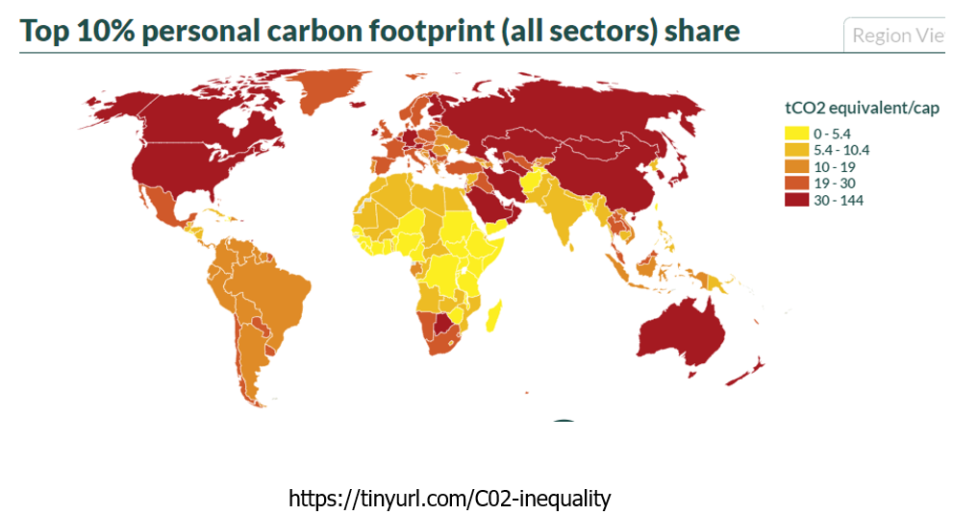
QUESTIONS OF CLIMATE JUSTICE: HOW DO WE COUNT?

Slide 28
WHEN DO WE START COUNTING?
What percentage of excess global emissions have come from the Global North / Global South since the industrial revolution? …Mark your estimate on the line…

Slide 29
CLIMATE JUSTICE: WHEN DO WE START COUNTING? HTTPS://INTHESETIMES.COM/ARTICLE/CLIMATE-CHANGE-WEALTHY-WESTERN-NATIONS-GLOBAL-NORTH-SOUTH-FIRES-WEST
What percentage of excess global emissions have come from the Global North since the Industrial Revolution?
92% 8%
Notes:
In a study done by Lancet Planetary Health, they found the Global North was responsible for 92% of global emissions (the US with 40% and the EU with 29%), with the study taking into consideration population and geographic size and the contributions since 1850 to emissions.

Slide 30
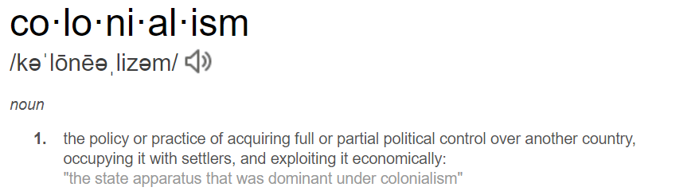
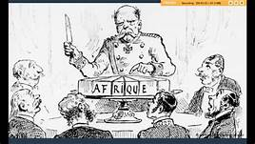

Slide 31
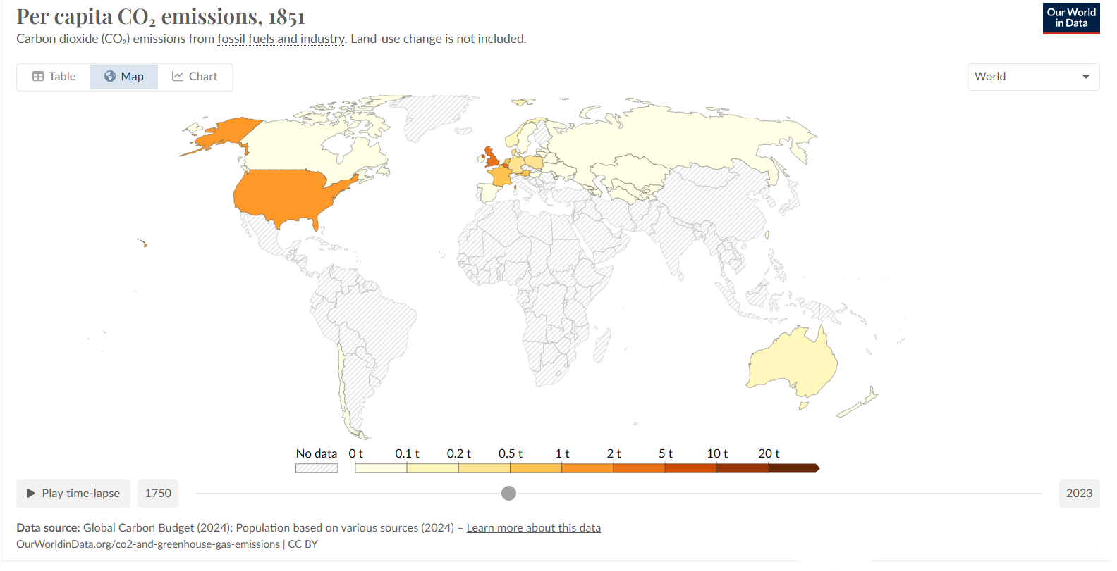
TIMELINE OF GLOBAL EMISSIONS HTTPS://OURWORLDINDATA.ORG/GRAPHER/CO-EMISSIONS-PER-CAPITA

Slide 32
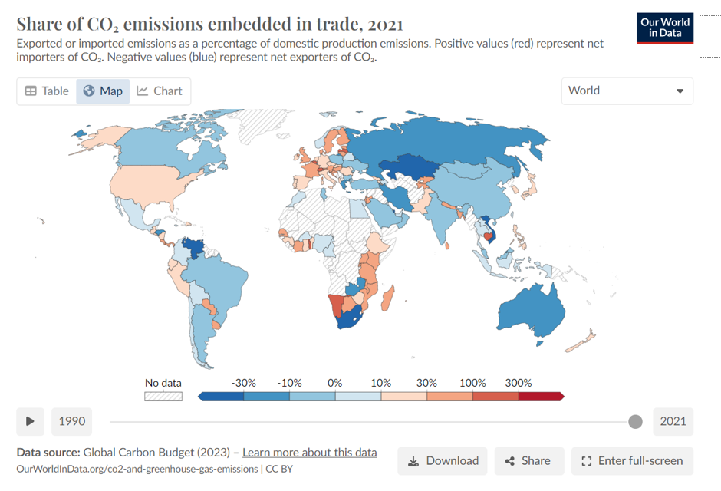
QUESTIONS OF CLIMATE JUSTICE WHERE DO WE COUNT?

Slide 33
WHAT DO WE COUNT
What is the biggest single institutional consumer of hydrocarbons in the world?

Slide 34

WAR AND PEACE - CLIMATE JUSTICE
US military is one of the largest polluters in history, consuming more liquid fuels and emitting more climate-changing gases than most medium-sized countries.
If the US military were a country, its fuel usage alone would make it the 47th largest emitter of greenhouse gases in the world, sitting between Peru and Portugal.
Discussion points: - Environmental impacts of war
- Military role in ‘securing’ gas and oil resource https://rgs-ibg.onlinelibrary.wiley.com/doi/10.1111/tran.12319

Slide 35
NARRATIVES OF BLAME AND CHANGE DISCUSSION
Opening question for small groups:
1. How do you define nature?
2. Are human being part of nature? According to common understanding of ‘nature’? What’s your opinion?
3. If not, what are we? Where does the idea of human beings as inherently greedy come from?

Slide 36
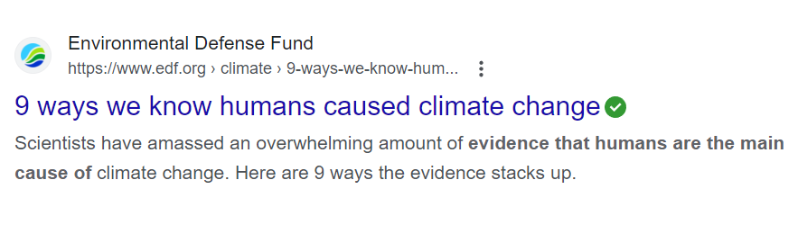
NARRATIVES OF CLIMATE CHANGE

Slide 37
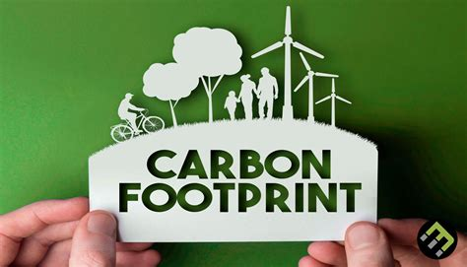

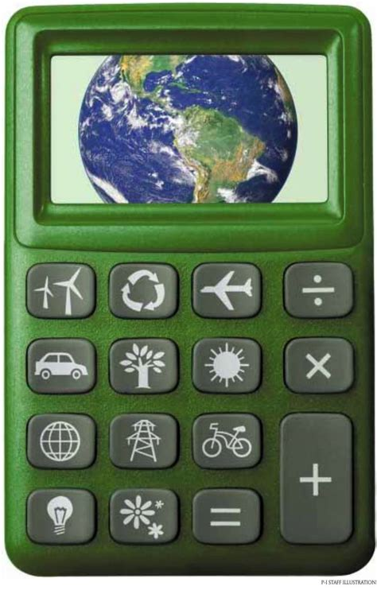
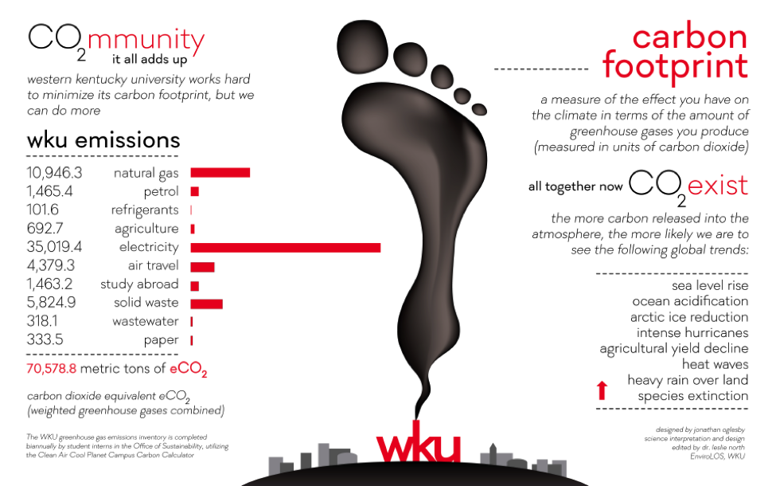

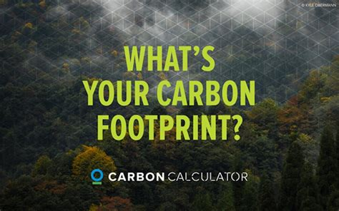
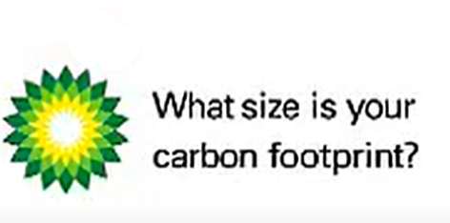
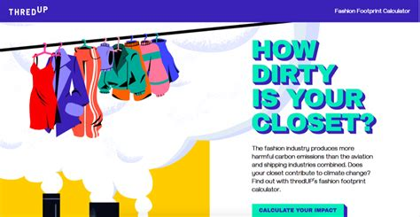
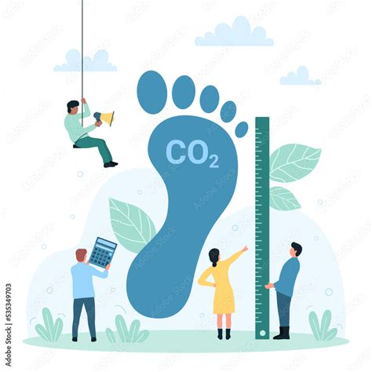

Slide 38
WHO COUNTS AS ‘PEOPLE’?
Student Research
Class /Small Group Discusssion:
Discuss the outcomes of this narrative of ‘people’ being to blame for climate change? Are corporations ‘people’? For decades they successfully lobbied to be recognised as ‘persons’ before the law?

Slide 39
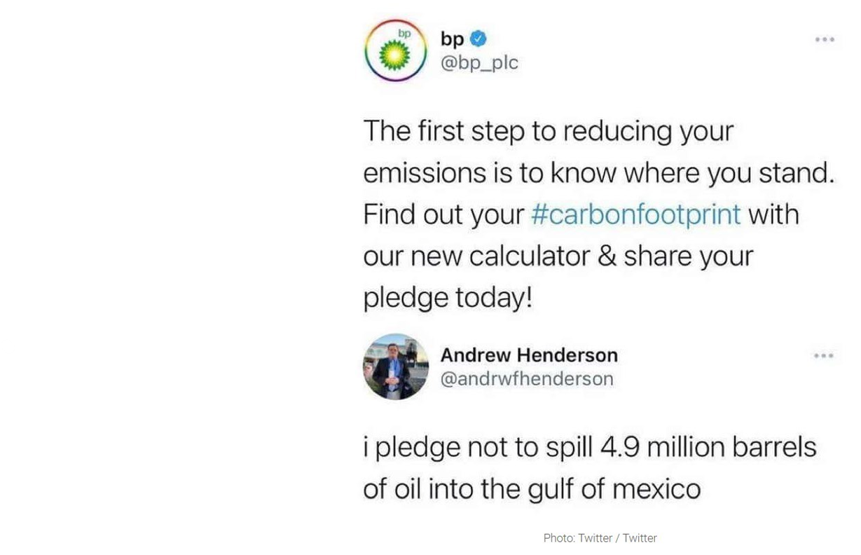
WHO COUNTS AS ‘PEOPLE’?
Class /Small Group Discusssion:
Discuss the outcomes of this narrative of ‘people’ being to blame for climate change? Are corporations ‘people’? They have successfully lobbied to be recognised as ‘persons’ before the law.
What’s the impact of treating corporations as ‘people’?
Student Research:
Research the origins of the ‘carbon footprint model’ and the impact of it. You can see the original BP ad here: www.youtube.com/watch?v=ywrZPypqSB4

Slide 40
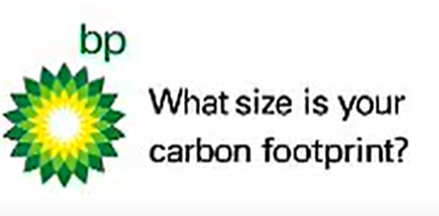
WHO COUNTS AS ‘PEOPLE’?
Student Research
Class /Small Group Discusssion:
Discuss the outcomes of this narrative of ‘people’ being to blame for climate change? Are corporations ‘people’? For decades they successfully lobbied to be recognised as ‘persons’ before the law? Corporations got a big boost with a US Supreme Court ruling in 2010. What was it? www.npr.org/templates/story/story.php?storyId=122805666
Look deeper into the impact of treating corporations as ‘people’? Summarise the pros and cons from this article: www.npr.org/2014/07/28/335288388/when-did-companies-become-people-excavating-the-legal-evolution ______
Research the origins of the ‘carbon footprint model’ and the impact of it. List any positives or negatives you see with this model. You can see the original BP ad (2003) here: www.youtube.com/watch?v=ywrZPypqSB4

Slide 41
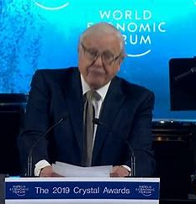
‘PEOPLE, THEY AIN’T NO GOOD’ WWW.VERSOBOOKS.COM/EN-GB/BLOGS/NEWS/2360-JASON-W-MOORE-ANTHROPOCENE-OR-CAPITALOCENE
"The Anthropocene makes for an easy story. Easy, because it does not challenge the naturalized inequalities, alienation, and violence inscribed in modernity’s strategic relations of power and production.
It is an easy story to tell because it does not ask us to think about these relations at all.
The mosaic of human activity in the web of life is reduced to an abstract Humanity: a homogeneous acting unit.
Inequality, commodification, imperialism, patriarchy, racial formations, and much more, have been largely removed from consideration.
At best, these relations are acknowledged, but as after-the-fact supplements to the framing of the problem.”

Slide 42
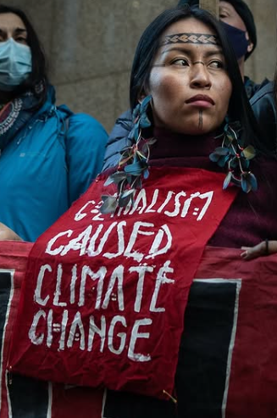
INDIGENOUS-LED CLIMATE ACTIONS
“Colonialism caused climate change. Our rights and traditional knowledge are the solution.” Brazilian Indigenous activist Taily Terena opened the Indigenous Peoples Pavilion at COP26 in Glasgow (2021)

Slide 43
WHO DO WE COUNT?
The richest 1% are responsible for more than twice as much carbon pollution than the poorest half of humanity.
To meet the 1.5°C goal, the richest 1% need to cut their emissions by 97% by 2030.

Slide 44
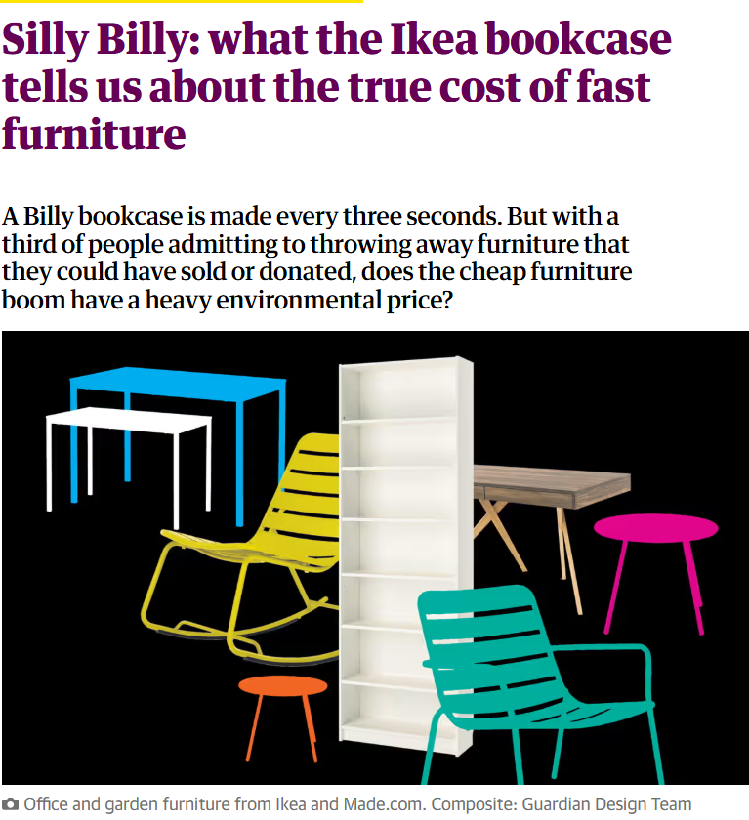
WHO DRIVES FAST-CONSUMER CULTURE?
Around the world an IKEA ‘Billy’ bookcase is sold every 5 seconds. “Get the prices down and you increase sales… __________ created that demand.”
(a) consumers
(b) corporations

Slide 45

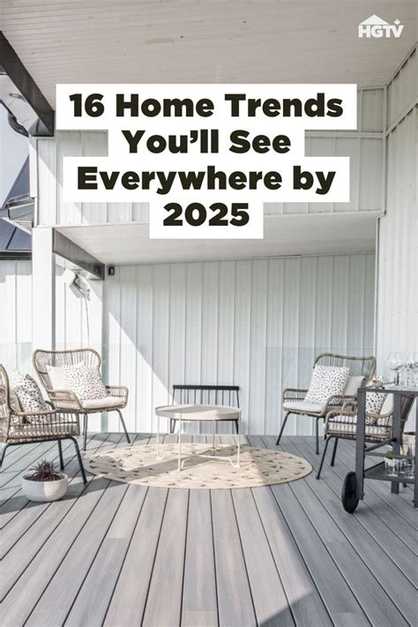


WHO DRIVES FAST-CONSUMER CULTURE?
“Get the prices down and you increase sales – we [Ikea] created that demand, not the consumer. That’s why I have a problem now with discussions about climate change, corporate-driven but we always talk about consumer behaviour.” A Billy bookcase is bought every 5 seconds. A Billy bookcase is produced every 3 seconds.

Slide 46
QUESTION: HOW MUCH DID EMISSIONS FALL IN 2020 (PANDEMIC LOCKDOWN?)
?%
Notes:
Can individual actions ever being enough to address a systemic problem?

Slide 47
HOW MUCH DID EMISSIONS FALL DURING LOCKDOWN?
4.6%
INDIVIDUAL AND SYSTEMIC ACTIONS ADDRESSING ROOT CAUSES
BUILDING RESILIENCE FAIRNESS AND ACCOUNTABILITY
(IMF 2022) https://www.imf.org/en/Blogs/Articles/2022/06/30/greenhouse-emissions-rise-to-record-erasing-drop-during-pandemic

Slide 48
QUESTION: TAKING ACTION FOR SYSTEMS CHANGE
WHICH COUNTRY WAS THE FIRST IN THE WORLD TO DIVEST ALL PUBLIC FUNDS FROM FOSSIL FUELS?

Slide 49
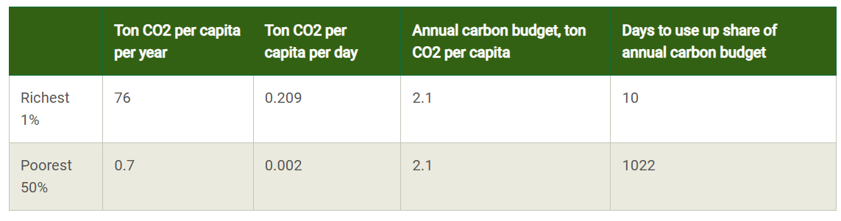
INDIVIDUAL BEHAVIOR CHANGE: 1% NEED TO CUT EMISSIONS BY 97%

Slide 50
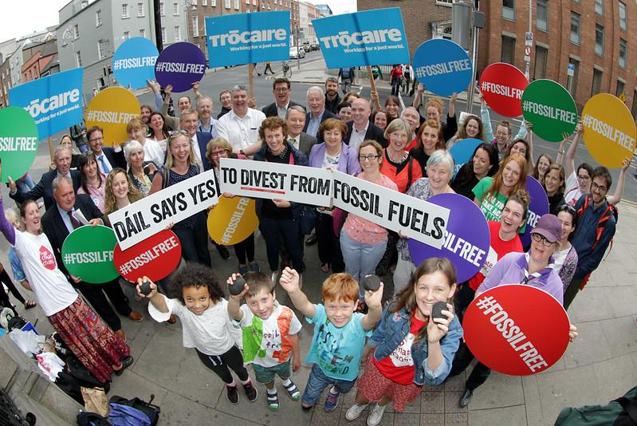
WHICH COUNTRY WAS THE FIRST IN THE WORLD TO DIVEST ALL PUBLIC FUNDS FROM FOSSIL FUELS? IRELAND

Slide 51
SYSTEM CHANGE – NOT CLIAMTE CHANGE

Slide 52
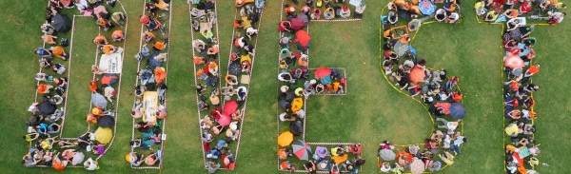
FIND OUT MORE
Read more about how the campaign was run:
Ireland leads the way in landmark Divestment Bill | Trócaire (trocaire.org)

Slide 53
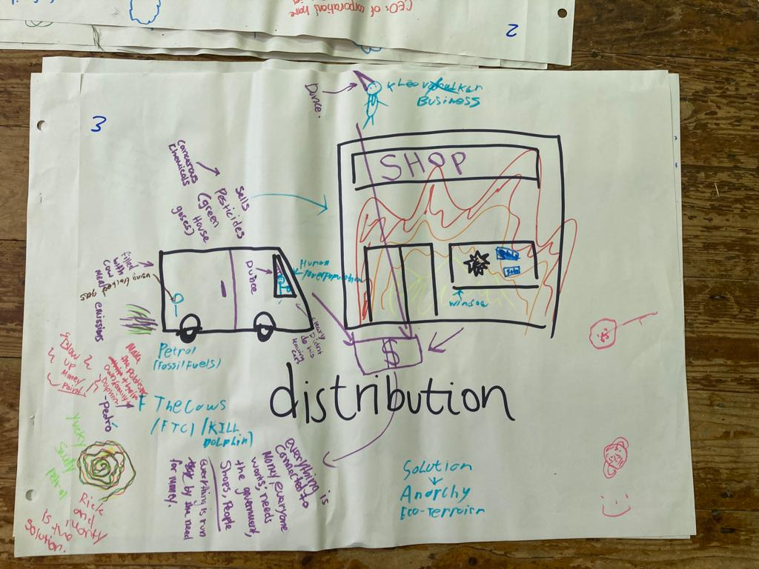
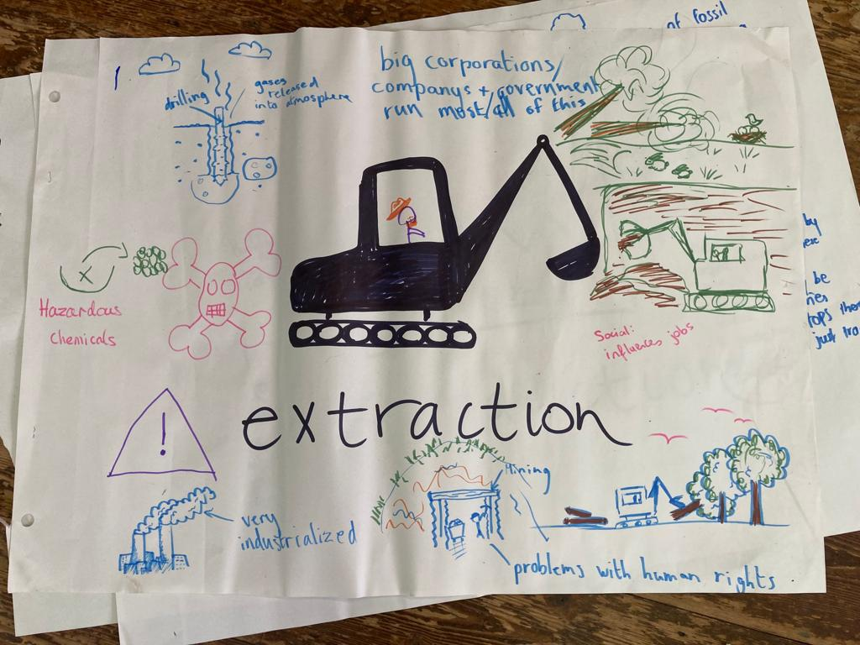
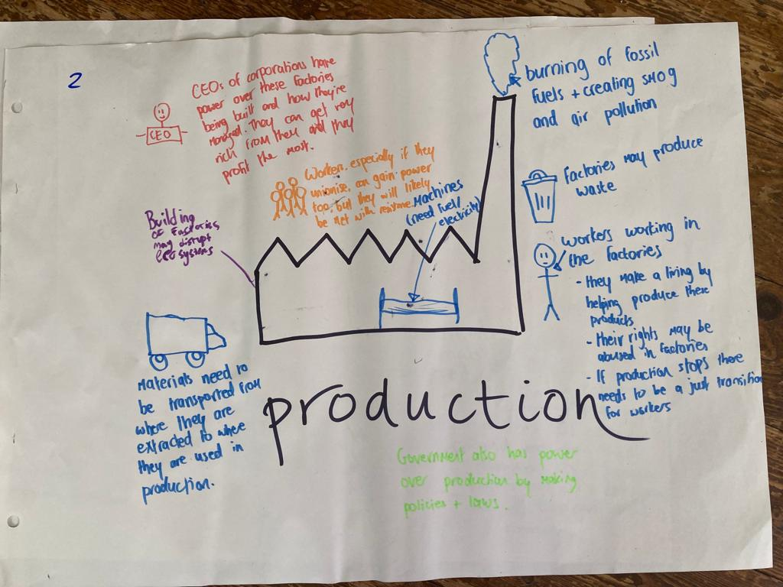
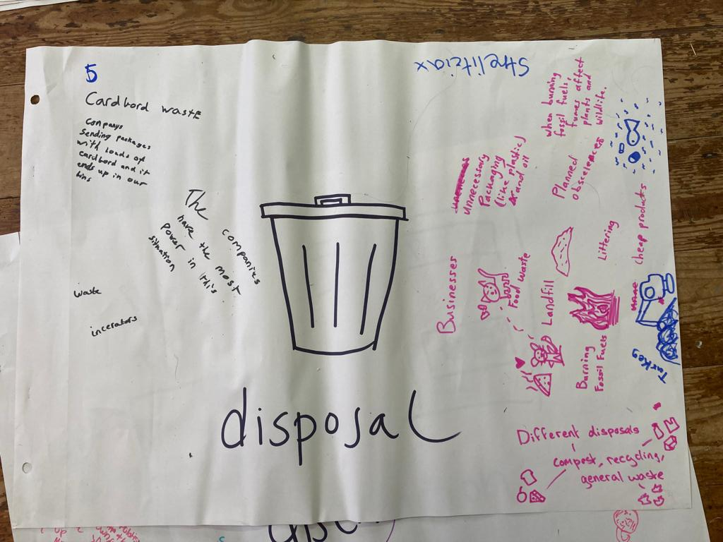
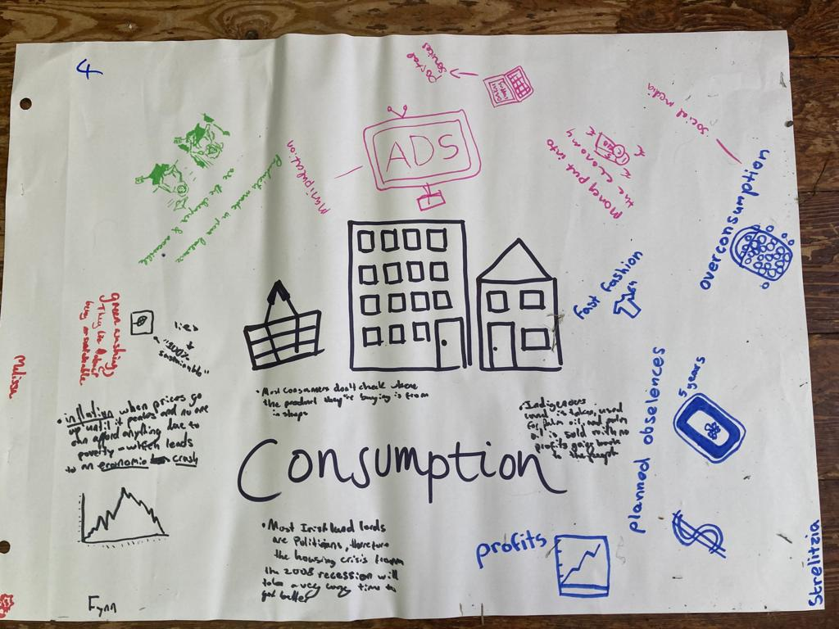
ACTIVITY: WHAT’S MISSING FROM THIS PICTURE?

Slide 54
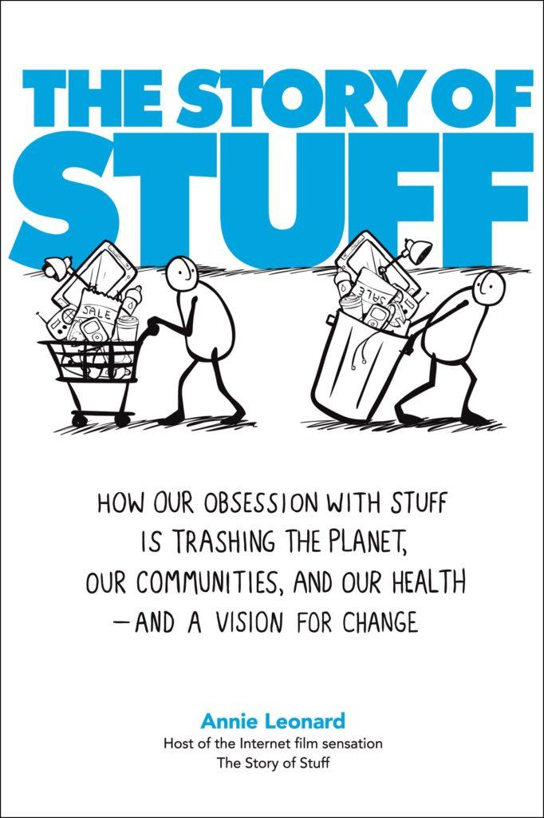
ACTIVITY: THE PRODUCTION CYCLE THE STORY OF STUFF (2010) FULL VIDEO: WWW.YOUTUBE.COM/WATCH?V=9GORQROIGQM
Activity 5 small groups / 5 large sheets: Extraction - Production - Distribution – Consumption - Disposal
- When it comes to climate action, where are actions generally focused? [Usually on disposal or consumption] - What other steps/elements are missing in this system? - Introduce the ‘finance’ and ‘design’ cards. Where would these go in the
Watch this introduction to The Story of Stuff until 1.44 min “People live and work all along this system…” https://www.youtube.com/watch?v=OqZMTY4V7Ts With subtitles Português www.youtube.com/watch?v=3c88_Z0FF4k
- What do you think is missing from this picture? Write and draw in your ideas. - Consider ‘justice’ questions. Do all people have the same power? Who benefits and who loses in this system? - Consider ideas for where broader actions (beyond individual behaviour changes) could be effective. Do we know of any groups taking action here?

Slide 55
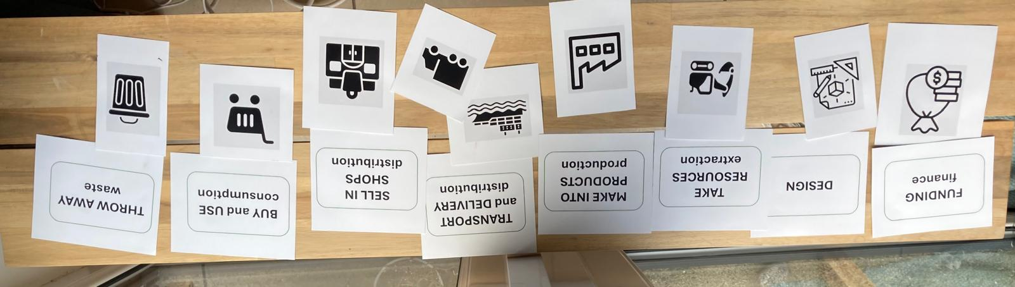
CLIMATE ACTION: POINTS OF INTERVENTION

Slide 56
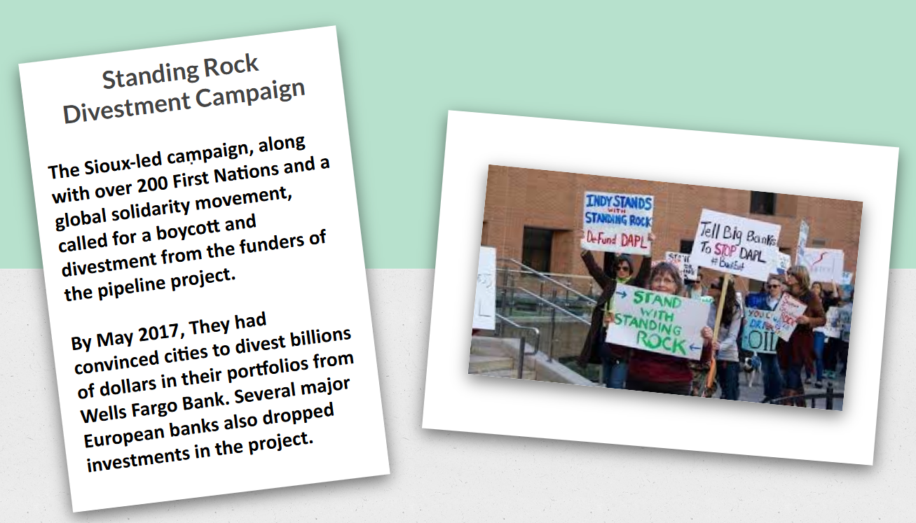
CLIMATE ACTION: POINTS OF INTERVENTION
Different climate actions can be taken at different points along this cycle. What points of intervention do you consider the most impactful? Look at the climate action cards – where would you place each card. Discuss the opportunities and challenges of each point of intervention. KEY DISCUSSION POINT: WHAT END OF THE SPECTRUM IS MOST IMPACTFUL IN TERMS OF ACTION? [Link to Impact Ranking Matrix] Sample case studies here: https://docs.google.com/presentation/d/1LqLpJejzSDQQN6ej-ovUiSFm5AP7jn5bgehscZx3XUc/edit?usp=sharing

Slide 57

ECONOWHA…?
The word economy comes from the Greek, for "household management.“ What kind of things does a household need to manage?
οἶκος, oikos, meaning "house/household".
Notes:
Point out that the economy is actually very different from household, but the purpose of this activity is to consider what they need to manage / and how they will manage. How would the household deal with people having different needs, and different capacities to contribute? For example, would they insist that people would only get resources if they paid for them?

Slide 58

SMALL GROUPS/ 5 MINUTES
What does a household need to manage?
- Say hello! - Someone to make sure everyone gets to contribute - Someone to feed back

Slide 59

ECONOWHA…? DEFINITION:
How people make decisions to satisfy their wants and needs, given limited resources.
The system of production, distribution, and consumption of goods and services within a society…to allocate resources effectively to meet peoples needs.
Notes:
Losts left out of this…what do you think this definition is missing?

Slide 60

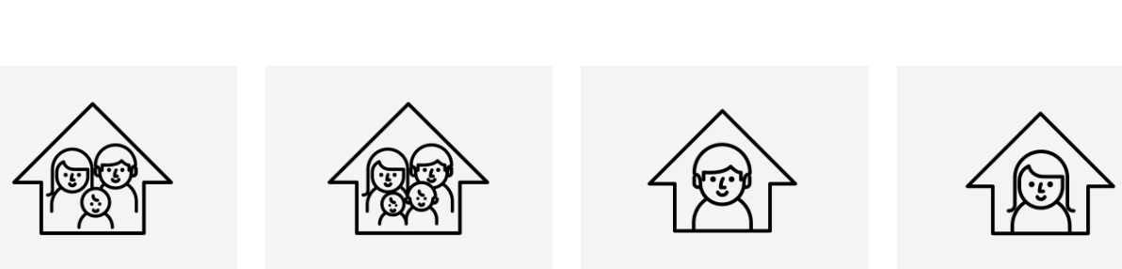
ARE ALL HOUSEHOLDS THE SAME? DOES EVERYONE IN THE HOUSEHOLD HAVE THE SAME NEEDS? HOW ARE PEOPLE'S DIVERSE NEEDS MET?

Slide 61
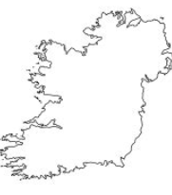

…WHAT ABOUT THE WIDER ECONOMY?
How are needs met? Are they met for all? If not, why not?

Slide 62
ECONOMICS AND POWER: DISTRIBUTION OF GLOBAL WEALTH
Richest 20% of world’s population controls
X%
of the world’s wealth
Poorest 80% of world’s population controls
X%
of the world’s wealth

Slide 63
DISTRIBUTION OF GLOBAL WEALTH
Richest 20% of world’s population controls
94%
of the world’s wealth
Poorest 80% controls
6%
of the world’s wealth
Notes:
Oxfam 2015

Slide 64
WHAT’S THE STORY… OF POVERTY AND WEALTH
WHY ARE SOME PEOPLE POOR WHY ARE SOME PEOPLE RICH?
WHY ARE SOME COUNTRIES ‘POOR?
WHY ARE SOME COUNTRIES ‘RICH’? What stories are we told about this? What underlying beliefs go with these stories? Within these stories, what are the ‘solutions’ to poverty? What’s left out of that story?

Slide 65



ECONOWAYS…OF LOOKING AT THE ECONOMY
Individual frame
Saving, cutting back on expenses…
Systemic frame
Dismantle economic policies that create or worsen poverty
(Changing the tax system, for example)

Slide 66
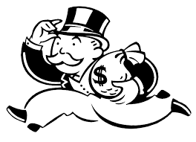
Let’s meet… Rational Economic Man
Rational "economic man: - He has all the information he needs to make decisions. - He acts rationally. - His aim is to get as much as he can for as little as possible. - He is driven by self interest – not by morals or care for others. “The presence of an economic man is an assumption of many economic models.” www.investopedia.com
Notes:
Rational Economic Man was a concept developed by economist Adam Smith (1723–1790) to predict human behaviour in the economy.

Slide 67
‘RATIONAL ECONOMIC MAN’
SMALL GROUP ACTIVITY / PART 1
What would ‘he’ be like as an individual?
How might he treat the environment?
How might he treat people?
What if he had something that others needed? (Even if he had more than he needed?) How would he handle that situation
Would he be into sports? If he played on a team, what would he be like?

Slide 68
REM Activity
Small Groups: 2 minute buzz Say hello - volunteer for feedback.
What if REM was actually a real person?
What would ‘he’ be like as an individual?
How might he treat people?
How might he treat the environment?
What if he had something that others needed? (Even if he had more than he needed?) How would he handle that situation
Would he be into sports? If he played on a team, what would he be like?
Get ready to feedback in the chat, or with your mic.

Slide 69

Rational Economic System..
ACTIVITY PART TWO
Imagine if Rational Economic Man was in charge of the economy – oran economic system based on the same values as REM? How would it treat people? The environment? How would it allocate resources e.g. a situation if people needed something – like housing?
Notes:
Are REM’s values in evidence in a world where 1,000 children die each day for lack of access to clean water, while the amount spent on bottled water is double the cost of addressing that life-saving need?

Slide 70
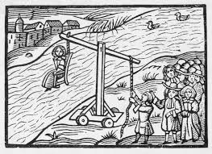
Rational Economic Woman?
Why was REM conceptualised as a ‘man’?
Could Adam Smith have imagined Rational Economic Woman in the 1700s?
“Women in Britain could not vote, own land while married, go to a university, earn equal wages, enter many professions, or even report serious cases of domestic abuse. Women who were found to be too argumentative or radical could deal with cruel and humiliating public penalties.” [under a law that was not repealed until 1967]
http://www.innertemplelibrary.org.uk/timeline/iwd-legal-history/

Slide 71
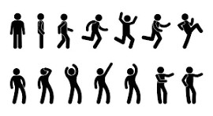
Notes on Rational Economic Man
Rational Economic Man was a concept developed by economist Adam Smith (1723–1790) to predict human behaviour in the economy. REM imagines human beings as individuals driven by selfishness, not by morals or care for others. His decisions are made based on perfect information and motivated by self interest. As a producer he is driven always to make the most profit, and his consumer choices are based on getting the most for his money. John Stuart Mill later expanded the concept with the idea that humans are driven by laziness and a desire for luxuries. Both Smith and Mill acknowledged that REM was a simplification of human nature for the sake of developing economic theory This concept emerged in the context of Enlightenment ideals of rationality, and scientific reasoning developed by Francis Bacon, Rene Descartes, John Locke and others. It was recognised that human beings have emotions but for the sake of economic modelling and market predictions, economics should leave all other elements of the human experience out.

Slide 72
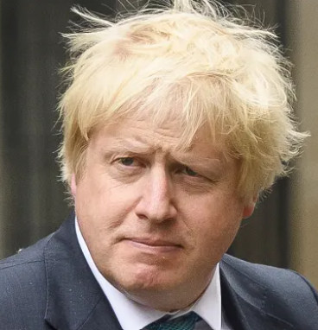
Greed is good.
“…Some measure of inequality is essential for the spirit of envy and keeping up with the Joneses that is, like greed, a valuable spur to economic activity.” Boris Johnson Speech at the Centre for Policy Studies' annual Margaret Thatcher lecture (November 2013) www.theguardian.com/politics/2013/nov/27/boris-johnson-thatcher-greed-good
Notes:
Discuss this in the context of the rise of Neoliberalism, with “Greed is good” as the oft cited mantra of the Thatcher years.

Slide 73
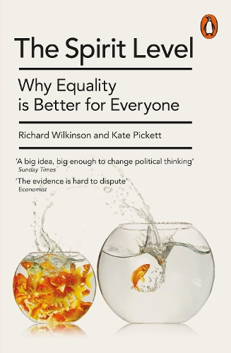
Another view?
Do we think that REM was born that way? What does this view of human activity and motivation leave out? For most of human history, human beings have engaged in high levels of cooperation – this quality is seen as essential to our survival and thriving as a species. There is strong evidence (2010) that more equal and cooperative societies benefit everyone: - Better physical and mental health - Less violence, lower crime rates and fewer people in prison
- Better outcomes in education - Higher levels of wellbeing

Slide 74
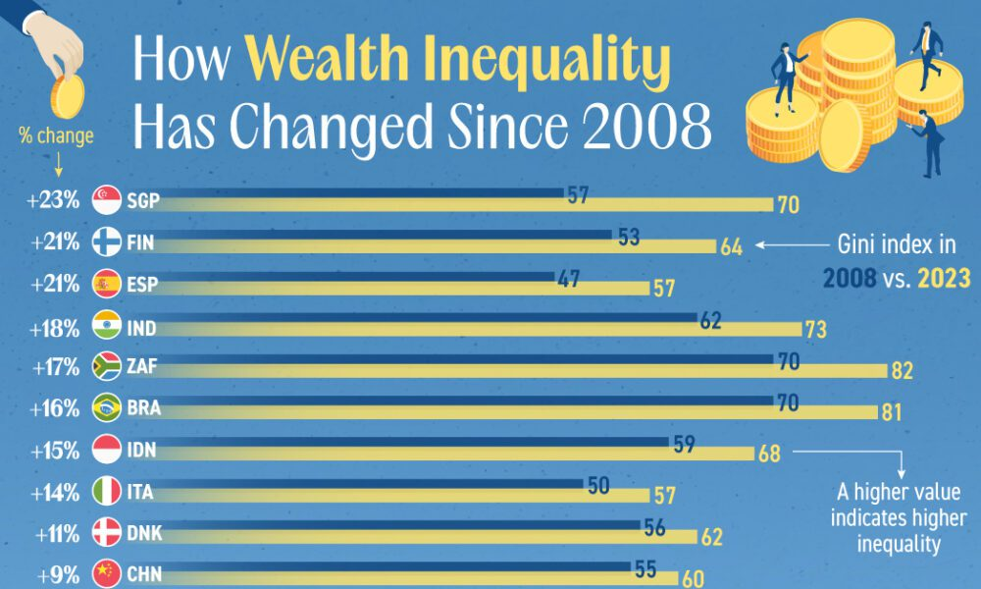
Visualcapitalist.com

Slide 75

WHAT MIGHT WE LEARN FROM FEMINIST ECONOMICS?
Feminist Economics : - Highlights the importance of care in social reproduction. -What isn’t counted isn’t valued: unpaid care work not counted in GDP -What would an ‘economics of care’ involve? -What might it teach/remind us about climate justice action?

Slide 76
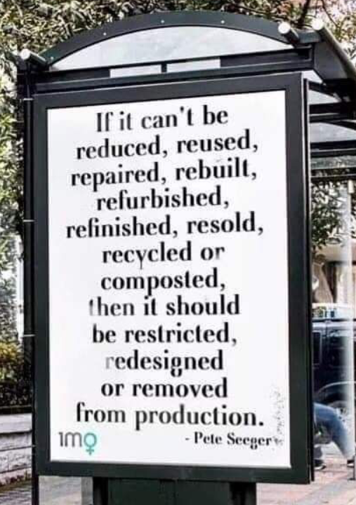
CAPITALISM AS AN OPERATING SYSTEM
What is the logic of the current economic system?
Endless growth
The system is fair and people are individuals, who have personal responsibility to meet their needs.
The value of something (or someone) is determined by money.
If something is free, it can be exploited.
Notes:
Assumptions about this system on the following slides can be printed and discussed in small groups.

Slide 77

ASSUMPTION: INDIVIDUAL RESPONSIBILITY
“There may be poverty because people don't know how to budget, don't know how to spend their earnings [it’s a] really hard fundamental character—personality defect.” www.margaretthatcher.org/document/103793

Slide 78

ASSUMPTION: ENDLESS GROWTH
Assumption that the economy, and profits for companies, should constantly grow.

Slide 79


ACTIVITY: OUR FAMILY PET
A thought experiment, inspired by eeconomist Marcos Arruda, who suggested that there is a dangerous confusion between growth and development.
They are often used interchangeably. But what are the consequences of thinking about development in this way?
- Development can, potentially, be sustainable.
- But growth will always come up against limits.

Slide 80

ACTIVITY: THE IMPORTANCE OF KNOWING THE DIFFERENCE BETWEEN ‘GROWTH’ AND ‘DEVELOPMENT’
To illustrate this imagine having a pet that never stopped growing – eventually we would have to accept that our ‘pet’ was actually a monster, because anything that perpetually grows, has to be perpetually fed, and this is not sustainable.
Similarly, a model of development based on endless growth (such as the dominant model) will soon put intolerable strain on the earth’s finite resources.

Slide 82

MARCOS ARRUDA: EDUCATION FOR WHOSE DEVELOPMENT? WWW.HARTFORD-HWP.COM/ARCHIVES/29/005.HTML
“Instead of being oriented to the development of the world's peoples, nations and regions, its targets are increasing corporate gains, productivity and competitiveness. The parameter of progress and civilization is the corporate growth, wealth accumulation and enhanced consumption. ”

Slide 83

A MODEL OF DEVELOPMENT BASED ON GROWTH WITHOUT LIMITS..?
We live within “a system of transformation and of self-expansion. In order to pursue the [mythical] goal of endless growth, it must constantly seek out new sites of accumulation, and commodify forms of social activity and processes that previously existed outside of the market.”
Is
Immanuel Wallerstein (2011) Historical Capitalism London: Verso.
Quoted in Conor McCabe (UCD, School of Social Justice) ‘Economics As If People Really Matter’ http://dublinopinion.com/2013/02/18/economics-as-if-people-really-mattered-galway-learning-circle-19-feb-10-april-introduction/

Slide 84

…IS A SYSTEM THAT PUTS US “…IN FUNDAMENTAL CONFLICT WITH NATURE.”
Is
(Clow 1994; Foster 2002) (pg. 215) in Veltmeyer, Henry (ed) 2011 The Critical Development Studies Handbook: Tools for Change London:Pluto Press

Slide 85

CLIMATE SPIRAL 1880-2022: HTTPS://YOUTUBE.COM/SHORTS/LFGBWGMSUVY?SI=4UHX3VMS_QXCHERT 2023: HTTPS://WWW.YOUTUBE.COM/WATCH?V=R7DBX5NLSR8
Reasons to ‘do’ Development Education/GCE: The average global surface temperature in 2023 was 1.48 degrees Celsius warmer than the pre-industrial averages. The Paris Agreement aims to hold global warming below 1.5C and well-below 2C, which scientists say is crucial for keeping earth's systems in balance.

Slide 86

REM ASSUMPTIONS
COMMODIFICATION OF NATURE
ENDLESS GROWTH and
PROFIT

Slide 87

ASSUMPTION: CARE SHOULD BE DONE FOR FREE
Only paid work that is seen as productive is valued and counted.
All the things that make ‘productive’ paid work possible, such as caring for children, elders, cooking, cleaning, educating, etc. is assumed to be done for free. What would happen if this work was withheld? Count ‘the economy’ function without it?

Slide 88
WHAT MIGHT WE LEARN FROM FEMINIST ECONOMICS?
Do we think that REM was born that way? For most of human history, human beings have engaged in high levels of cooperation. To this day, our daily lives are full examples of care, mutual support and cooperation. Feminist Economics : - Highlights the importance of care in social reproduction. -What isn’t counted isn’t valued: unpaid care work not counted in GDP -What might an economics of care’ involve?

Slide 89

ASSUMPTION: NATURE IS A RESOURCE TO BE USED
‘Natural Resources’ are there to be used, if you can. Nature is also expected to absorb pollution, or other forms of damage caused in the pursuit of profit. What would happen to ‘the economy’ if it had to pay attention to the rights and limits of nature?

Slide 90



JUST TAX (2024) WWW.FINANCIALJUSTICE.IE/LEARN/JUST-TAX-A-GLOBAL-EDUCATION-TOOLKIT-FOR-TEACHING-AND-LEARNIN/
ACTIVITY 7 Up in Smoke Activities on a climate justice approach to carbon taxes. ACTIVITY 15: Mining Rights and Wrongs

Slide 91

REFLECTION
Something you can see around you, or something in your life that you consider priceless

Slide 92
THE WORLD WE WANT…
DEVELOPMENT RANKING ACTIVITY Work in small groups to create your own model/definition of development according to your values, needs, and priorities.
Share your model with the other groups, and listen to theirs.
What do you notice?

Slide 93
THANK YOU! REFLECTION
Something you enjoyed
Something that struck you
Something you’d like to explore more
Something you’d change

Slide 94
INTRODUCTIONS:
HOW DO YOU FEEL ABOUT CLIMATE ACTION IN 2025? - CONCERNS? - OPPORTUNITIES? - HOPE?

Slide 95

THE BEST TIME TO BE A CLIMATE JUSTICE ACTIVIST ?
Climate change denial
Boost for fossil fuel industries Discrediting renewables
Deregulation / dismantling environmental protections
Denial and repression of refugee rights – 30 million people displaced by climate change each year
Threat of economic sanctions and/or military force to take control of strategic and resource-rich countries

Slide 96

GLOBAL JUSTICE EDUCATION
Addresses global concerns, such as the root causes and consequences of poverty, inequality, conflict and environmental issues… Identifies these as justice issues that require a rights-based, solidarity approach
Assumes a level of interconnectedness – and involves an analysis of power and the historical and political forces that create and maintain local and global inequalities
Builds critical awareness, recognising and learning from diverse forms of knowledge
Encourages informed individual and collective solidarity action

Slide 97


ACTIVITY: HOW SHOULD WE HANDLE WASTE?
Broadening the focus beyond individual actions and opening discussion on systems change. Ranking Activity
What’s the best way to deal with waste?
What’s the best for the environment?
Explore dominant narratives: ‘Recycling’ frequently comes out on top (when it actually ranks 9th place): what is the underlying message?

Slide 98
REPAIR
REPURPOSE
REFILL
REDUCE
REFUSE (Say no!)
RECYCLE
RECHARGE
REUSE
RETHINK

Slide 99
CLIMATE ACTIONS
Thinking beyond the obsession with ‘recycling’. ‘Rethink’ – what should/could we rethink?
What could be reimagined?

Slide 100
ACTIVITY: THE PRODUCTION CYCLE THE STORY OF STUFF (2010) FULL VIDEO: WWW.YOUTUBE.COM/WATCH?V=9GORQROIGQM
Activity 5 small groups / 5 large sheets: Extraction - Production - Distribution – Consumption - Disposal
- When it comes to climate action, where are actions generally focussed? [Usually on disposal or consumption] - What other steps/elements are missing in this system?
Watch this introduction to The Story of Stuff until 1.44 min “People live and work all along this system…” https://www.youtube.com/watch?v=OqZMTY4V7Ts With subtitles português www.youtube.com/watch?v=3c88_Z0FF4k
- What do you think is missing from this picture? Write and draw in your ideas. - Consider ‘justice’ questions. Do all people have the same power? Who benefits and who loses in this system? - Consider ideas for where broader actions (beyond individual behaviour changes) could be effective. Do we know of any groups taking action here?

Slide 101
ACTIVITY: WHAT’S MISSING FROM THIS PICTURE?

Slide 102


Slide 103

CLIMATE ACTION
Thinking about Points of Intervention for change
MATCH THE ACTION TO THE STAGE OF PRODUCTION WAS THIS AN EFFECTIVE ACTION, IN YOUR OPINION? WHY?

Slide 104




Slide 105

Consider these actions to protect the ozone layer. What point of intervention is this action located in? Which actions are the most effective? Why?
Individual consumers stop using products containing CFCs
Pressure companies to stop using CFCs in their products
Lobby politicians and campaign for a ban on the use of CFCs here would you place each in the production cycle.
“Yes, but…” dialogues in pairs. “Points of intervention furthest up the line are the most effective” Debrief: summarise your thoughts on the pros and cons of actions at the various points.
Follow up with an exploration of the Impact ranking matrix.
Notes:
Example a

Slide 106
Protect the Ozone Layer
- Go CFC Free! A campaign led by Greenpeace and others in the 1980s to end the use of CFCs in aerosols and cooling systems. Public awareness helped to push companies to redesign their products, and led governments to sign an agreement in 1987 phase out CFCs.
www.theguardian.com/environment/2019/jan/20/how-to-stop-the-climate-crisis-six-lessons-from-the-campaign-that-saved-the-ozone
Notes:
https://www.theguardian.com/environment/2019/jan/20/how-to-stop-the-climate-crisis-six-lessons-from-the-campaign-that-saved-the-ozone

Slide 107

Litter & Waste Monitors Students and teachers on Green Schools committees carry out a range of actions to educate, promote, and monitor proper sorting of waste and recycling in their classrooms, schools and wider communities.

Slide 108

Students at UCC campaigned successfully for and end to single use plastics on campus. Since January 2023 the canteen, cafes, and vending machines and shop no longer stock single use plastics, saving an estimated 1 million coffee cups from landfill within a year.
Plastic-free UCC
www.ucc.ie/en/news/2023/ucc-saves-1-million-plastic-cups-from-landfill.html
Notes:
https://www.ucc.ie/en/news/2023/ucc-saves-1-million-plastic-cups-from-landfill.html

Slide 109

TY students at Kinsale Community School, partnered with Transition Town Kinsale, to launch a reusable cup deposit scheme to tackle single-use plastics in the school and wider community.
They hope to inspire more local businesses to follow suit.
‘What’s Up With The Cup’
www.kinsalecommunityschool.ie/news/2024/4/14/whats-up-with-the-cup
Notes:
https://www.kinsalecommunityschool.ie/news/2024/4/14/whats-up-with-the-cup

Slide 110

‘End of the Road’ Ende Gelände Up to 4,000 environmental activists from the group Ende Gelände broke through police lines and blocked train tracks at three major coal mines in eastern Germany.
The action aimed to prevent the transporation of coal to power plants, and was part of their call on government for the immediate phasing out of coal.
www.dw.com/en/climate-protesters-storm-german-coal-mines/a-51481884
Notes:
https://www.dw.com/en/climate-protesters-storm-german-coal-mines/a-51481884

Slide 111

Standing Rock Divestment Campaign .
The Sioux-led campaign, along with over 200 First Nations and a global solidarity movement, called for a boycott and divestment from the funders of the pipeline project. By May 2017, the campaign had convinced cities to divest billions of dollars in their portfolios from Wells Fargo Bank. Several major European banks also dropped investments in the project.
www.climatechange.ie/divestment-movement-builds-against-dakota-access-pipeline/
Notes:
https://www.climatechange.ie/divestment-movement-builds-against-dakota-access-pipeline/

Slide 112

In 2017, Ireland passed a law to ban hydraulic fracking, a controversial process that fractures rock to extract gas or oil. The movement grew from a local anti-fracking campaign, Love Leitrim, that went on to demand a nationwide ban. The campaign was joined by a range of groups, activists, and politicians including Friends of the Earth. In December 2024, Ministers in Stormont also voted to ban fracking in Northern Ireland.
Ireland Bans Fracking
www.friendsoftheearth.ie/news/ireland-bans-fracking/
Notes:
https://www.friendsoftheearth.ie/news/ireland-bans-fracking/ https://www.rte.ie/news/regional/2024/1205/1484967-fracking-ni-ban/ Photo: Leah Farrell / rollingnews.ie

Slide 113
‘End of the Road’ Ende Gelände Up to 4,000 environmental activists from the group Ende Gelände broke through police lines and blocked train tracks at three major coal mines in eastern Germany.
The action aimed to prevent the transporation of coal to power plants, and was part of their call on government for the immediate phasing out of coal.
Notes:
https://www.dw.com/en/climate-protesters-storm-german-coal-mines/a-51481884

Slide 114

SHOP and DROP
This campaign encouraged shoppers in Ireland to leave all excess plastic packaging behind at supermarkets to pressure the companies to ditch plastic. Days of Action were held in 2018 and 2019.
Lidl and Aldi introduced permanent recycling bins in their stores in response. The campaigners say this misses the point - the solution is to remove the plastic completely.
www.voiceireland.org/campaign/shop-and-drop
Notes:
https://www.voiceireland.org/campaign/shop-and-drop https://www.irishexaminer.com/news/arid-30838492.html Plastics are a climate issue, as the extraction, refining and manufacture of plastics are all carbon intensive activities.

Slide 115

Friends of the Irish Environment: In 2019 Friends of the Irish Environment took legal case to hold the government accountable for failing to act, and knowingly contributing to dangerous levels of climate change. In 2020, the group won in court when Supreme Court ordered the government to develop a more ambitious climate strategy.
Climate Case Ireland
Notes:
https://www.climatecaseireland.ie/climate-case/

Slide 116
WHAT ELSE?!

Slide 117

DEBT AND TAX ARE CLIMATE JUSTICE ISSUES HTTPS://WWW.EURODAD.ORG/CLIMATE_DEBT_FAQS
“ A tale of two emergencies”

Slide 118

SUBSIDIES – TAXES
$1.4tn of public money went into fossil fuel subsidies in G20 countries in 2022.
International Institute for Sustainable Development (IISD) https://www.theguardian.com/environment/2023/aug/23/g20-poured-more-than-1tn-on-fossil-fuel-subsidies-despite-cop26-pledges-report

Slide 119

TAX AND CLIMATE
2025: teachable tax justice moments!

Slide 120
BANKING ON CLIMATE CHANGE
Quiz questions to introduce banking regulation regarding finance for the fossil fuel industry. Self-guided learning on

Slide 121


BANKING ON CLIMATE CHAOS WWW.BANKINGONCLIMATECHAOS.ORG/?BANK=JPMORGAN%20CHASE#FULLDATA-PANEL
Annual reports Stories from the frontlines – case studies of climate finance and its impact in communities around the world. Plain English, and searchable for students to create summaries and their own case studies.

Slide 122
WHO SAID IT..?
“Unsubstantiated, shrill, partisan, self-serving, apocalyptic warnings are ALWAYS wrong”
[…in response to comments by UN officials on the risks of global heating.]

Slide 123
WHO SAID IT…?
“Investors need not worry about climate risk,”
and complained about having to spend time, “looking at something that’s going to happen in 20 or 30 years”

Slide 124
WHO SAID IT…?
“Who cares if Miami is six metres underwater in 100 years? Amsterdam has been six metres underwater for ages and that’s a really nice place.”

Slide 125

All quotes from the head of ethical investing at HSBC, Stuart Kirk www.theguardian.com/business/2022/may/22/hsbc-suspends-head-of-responsible-investing-who-called-climate-warnings-shrill

Slide 126


Slide 127
QUESTION
WHAT DOES
GFANZ
STAND FOR?

Slide 128

ANSWER: GLASGOW FINANCIAL ALLIANCE FOR NET ZERO
GFANZ was launched at COP 26 in Glasgow.
Made up of 450 banking and financial organisations in 45 countries with assets of more than $130tn.

Slide 129

GLASGOW FINANCIAL ALLIANCE FOR NET ZERO GFANZ (APRIL’ 21) INTERNATIONAL ENERGY AGENCY (IEA): NO NEW FOSSIL FUEL PROJECTS
By 2023… 56 of the biggest banks in the net-zero banking alliance grouping (NZBA) had provided $270bn to 102 fossil fuel companies for their expansion
HSBC had approved 58 deals worth $12bn in capital to fossil fuel developers.
https://www.theguardian.com/environment/2023/jan/17/banks-still-investing-heavily-in-fossil-fuels-despite-net-zero-pledges-study

Slide 130

BANKING ON CLIMATE HTTPS://ACTIONAID.ORG/PUBLICATIONS/2023/HOW-FINANCE-FLOWS-BANKS-FUELLING-CLIMATE-CRISIS PS://WWW.THEGUARDIAN.COM/ENVIRONMENT3/JAN/17/BANKS-STILL-INVESTING-HEAVILY-IN-FOSSIL-FUELS-DESPITE-NET-ZERO-PLEDGES-S
By 2023, banks provided the fossil fuel industry in the Global South US$3.2 trillion in the seven years since the Paris Agreement on Climate Change was adopted in 2016.
Fossil fuel and industrial agriculture industries in the Global South are receiving an annual average of 20 times more financing from banks than governments are receiving for climate solutions.

Slide 131

NET ZERO BANKING ALLIANCE WWW.THEGUARDIAN.COM/COMMENTISFREE/2025/JAN/15/WOKE-CAPITAL-NET-ZERO-BANKING-ALLIANCE
VOLUNTARY NON-BINDING EXODUS SINCE US ELECTIONS

Slide 132

CLIMATE FINANCE- WHO SHOULD PAY? HTTPS://NEWS.MONGABAY.COM/SHORT-ARTICLE/125B-IN-CLIMATE-FINANCE-FUNDS-POLLUTING-RIGHTS-VIOLATING-PROJECTS-REPORT/
CLIMATE FINANCE AS DEBT (60%+) A BOOST FOR PRIVATE SECTOR USING PUBLIC FUNDS TO ‘DE-RISK’ PRIVATE INVESTMENT

Slide 133

THE FINANCIALISATION OF AID: ‘FROM BILLIONS TO TRILLIONS’

Slide 134
Rational Economic Man
Rational Economic Man is a concept associated with economist Adam Smith (1723–1790) to predict human behaviour in the economy. His decisions are made based on perfect information and motivated by self interest. As a producer he is driven always to make the most profit, and his consumer choices are based on getting the most for his money. John Stuart Mill later expanded the concept with the idea that humans are driven by laziness and a desire for luxuries. REM imagines human beings as individuals driven by selfishness, not by morals or care for others. They express themselves and relate to others through the Market, rather than the complex web of social relations, and our fundamental dependency on others. Both Smith and Mill acknowledged that REM was a simplification of human nature for the sake of developing economic theory.

Slide 135
Rational Economic Woman?
Why was REM conceptualised as a ‘man’?
Could Adam Smith have imagined Rational Economic Woman in the 1700s?
“Women in Britain could not vote, own land while married, go to a university, earn equal wages, enter many professions, or even report serious cases of domestic abuse. Women who were found to be too argumentative or radical could deal with cruel and humiliating public penalties.” [under a law that was not repealed until 1967]
http://www.innertemplelibrary.org.uk/timeline/iwd-legal-history/

Slide 136
Rational Economic Man
Rational Economic Man (REM) was a concept associated with economist Adam Smith (1723–1790) to predict human behaviour in the economy. John Stuart Mill later expanded the concept.
REM imagines human beings as individuals driven by selfishness, not by morals or care for others. His decisions are made based on perfect information and motivated by self interest. As a producer he is driven always to make the most profit, and his consumer choices are based on getting the most for his money. Mill added that humans are driven by laziness and a desire for luxuries.
Both Smith and Mill acknowledged that REM was a simplification of human nature for the sake of developing economic theory, however the concept has endured in economic theory for over 200 years. “For most of the past two centuries, economic thinking has been dominated by the concept of Homo economicus… Paul Krugman (New York Review of Books, 2007)

Slide 137
Rational Economic Man Definition
Rational "economic man" ("homo economicus") is an idealized person who acts rationally, with perfect knowledge, and is motivated to maximize personal utility or satisfaction. This concept emerged in the context of Enlightenment ideals of rationality, and scientific reasoning developed by Francis Bacon, Rene Descartes, John Locke and others It was recognised that human beings have emotions but for the sake of economic modelling and market predictions, economics should leave all other elements of the human experience out.
“The presence of an economic man is an assumption of many economic models.” www.investopedia.com

Slide 138

ENERGY TRANSITION MYTH-BUSTER WWW.TNI.ORG/EN/PUBLICATION/ENERGY-TRANSITION-MYTHBUSTERS
‘This report from the Trasnational Institute aims to challenge six harmful but influential energy transition myths. These myths aim to persuade us that the private sector, free markets, cheaper prices and decentralisation can decarbonise the energy system — and that intellectual property rights and trade and investment protection agreements are necessary to facilitate this.
These myths keep policy-makers, social movements and communities from defending, building and advocating for real solutions: public power systems that can democratically decarbonise society.’

Slide 139

FJI RESOURCES WWW.FINANCIALJUSTICE.IE/LEARN/
Addressing questions about the role of finance in driving climate change
Critical thinking about the diversion of funds from aid and development commitments, rather than pledges of new funding

Slide 140

LINKS TO CURRICULUM
ECONOMICS OF THE FASHION INDUSTRY
FUNDING FOR INDUSTRIAL AGRICULTURE
ETHICS OF CLIMATE CHANGE and DEMANDS OF THE CLIMATE JUSTICE MOVEMENT

Slide 141

PLAIN ENGLISH ECONOMICS
www.financialjustice.ie/learn/

Slide 142
JUST TAX (2024) WWW.FINANCIALJUSTICE.IE/LEARN/JUST-TAX-A-GLOBAL-EDUCATION-TOOLKIT-FOR-TEACHING-AND-LEARNIN/
ACTIVITY 7 Up in Smoke Activities on a climate justice approach to carbon taxes. ACTIVITY 15: Mining Rights and Wrongs

Slide 143

EXPLORING ALTERNATIVES
CLIMATE ECONOMICS
JUST TRANSITION
DOUGHNUT ECONOMICS
DEGROWTH
POST GROWTH
Image: Degrowth Network Scotland

